Slide 1

SDP end-term evaluation
Smart IoT-based Agriculture monitoring system for disease detection with accurate spraying mechanism using Raspberry Pi 4
Supervised By: Dr. Monalisa Panda
Group No: L6
Prayas Das: 2041004033
Tilak Kumar Mishra: 2041013093
Suraj Parida: 2151016006
Rubal Yadav: 2041025004
Department of Computer Sc. and Engineering
Faculty of Engineering & Technology (ITER)
Siksha ‘O’ Anusandhan (Deemed to be) University
Bhubaneswar, Odisha
Notes:
Smart IoT-based Agriculture monitoring system for disease detection with accurate spraying mechanism using Raspberry Pi 4

Slide 2
Presentation Outline
Introduction
Motivations
Uniqueness of the work
Literature Survey
Existing System
Problem Identification
Model Diagram
Hardware Implementation
Methodology used
CNN Architecture
Experimentation and Results
System Specifications
Datasets Description
Experimental outcomes
Future Scope
Summary
Bibliography

Slide 3
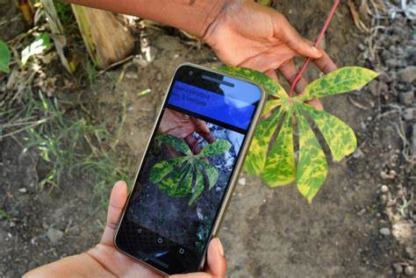
Introduction
Our project introduces a Smart IoT-based Agriculture Monitoring System.
It utilizes Raspberry Pi 4 and CNN algorithm for precise disease detection and targeted spraying.
By leveraging high-resolution cameras and AI algorithms.
It revolutionizes agriculture, empowering farmers to optimize resources and mitigate crop damage sustainably.
Fig 1: Analyzing leaf health using a cellphone

Slide 4
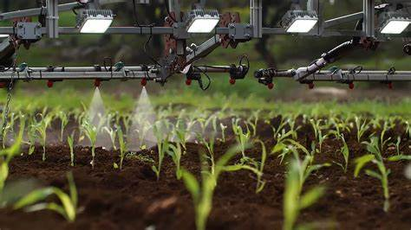
Introduction contd..
The motivation behind our Smart IoT-based Agriculture Monitoring System stems from several key factors driving the need for innovation in agricultural practices:
Enhanced Productivity
Sustainable Agriculture
Timely Disease Detection
Efficient Resource Management
Empowering Farmers
Fig 2: Greeneye Technology

Slide 5
Literature Survey
Table 1: Literature Survey
Aspect | Description | Reference
IoT in Agriculture | Provides solutions for crop monitoring (remote sensors), irrigation management (smart irrigation systems), and pest control (automated traps). | Maes, W. H., & Steppe, K. (2019). Perspectives for remote sensing with unmanned aerial vehicles in precision agriculture. Trends in plant science, 24(2), 152-164.
Disease Detection in Agriculture | Existing methods include manual inspection (visual by farmers), remote sensing (satellite imagery), and image processing techniques (automated disease identification using cameras). | Neupane, K., & Baysal-Gurel, F. (2021). Automatic identification and monitoring of plant diseases using unmanned aerial vehicles: A review. Remote Sensing, 13(19), 3841.
Raspberry Pi in Agriculture | A cost-effective, versatile computer used for building automation and monitoring systems in agriculture. It can be integrated with sensors for data collection and control functions. | Morais, R., Silva, N., Mendes, J., Adão, T., Pádua, L., López-Riquelme, J. A., ... & Peres, E. (2019). mySense: A comprehensive data management environment to improve precision agriculture practices. Computers and Electronics in Agriculture, 162, 882-894.
Potential Challenges and Future Directions | Challenges in implementation (data management, scalability, power requirements, etc.) [19]Integration with other precision agriculture technologies [20]Scope for further research and improvements [21] | Karunathilake, E. M. B. M., Le, A. T., Heo, S., Chung, Y. S., & Mansoor, S. (2023). The path to smart farming: Innovations and opportunities in precision agriculture. Agriculture, 13(8), 1593.

Slide 6
Literature Survey Contd..
Problem Statement
Current Challenges:
Traditional agricultural monitoring systems, which heavily rely on sensors, face precision limitations, particularly in detecting diseases.
Implementing effective spraying mechanisms is challenging with current sensor-dependent agricultural systems.
Proposed Solution:
Strategically placed high-resolution cameras enhance monitoring by providing detailed visual data, surpassing traditional sensor-only systems.
State-of-the-art Convolutional Neural Networks (CNNs) analyze captured images with unprecedented accuracy for disease identification and optimized spraying mechanisms.

Slide 7
Model Diagram
Batteries
DC Pumps
Relays
Raspberry Pi 4
Fig 3: Circuit Diagram of Model
7

Slide 8
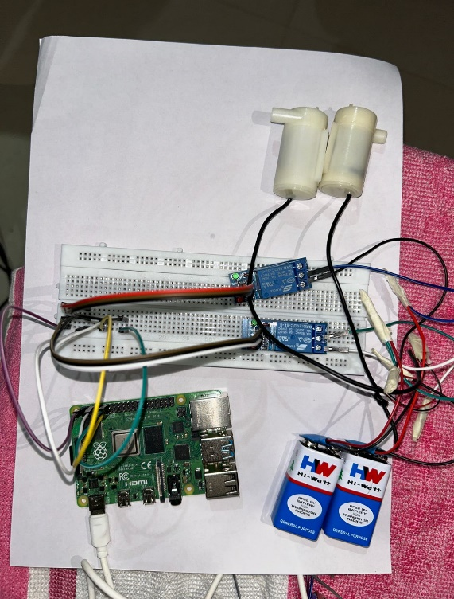
Hardware Implementation
Image Capture: Utilize cameras to capture images of crops.
RGB Analysis: Analyze RGB values of the images to distinguish between healthy and diseased crops.
Disease Detection: Process RGB values to identify irregularities or diseases
Automated Response: Detect issues (e.g., disease) and trigger the relay system.
Fig 4: Hardware Implementation of Model

Slide 9
Methodology used
Our solution introduces a Smart IoT-based Agriculture Monitoring System tailored for precise disease detection and targeted spraying mechanisms, leveraging the power of Raspberry Pi 4 and CNN algorithms.
IoT Integration: By using the pi camera in agriculture. We achieve real-time monitoring with high resolution imaging at a low cost. This helps in detecting issues early, analyzing crop health and making data-driven decisions efficiency and productivity
Advanced CNN Algorithm: Employing Convolutional Neural Networks (CNNs), our system analyzes high-resolution images captured by cameras installed in the fields.
Raspberry Pi 4 as Central Hub: Serving as the central processing unit, Raspberry Pi 4 efficiently manages data aggregation, processing, and decision-making.

Slide 10
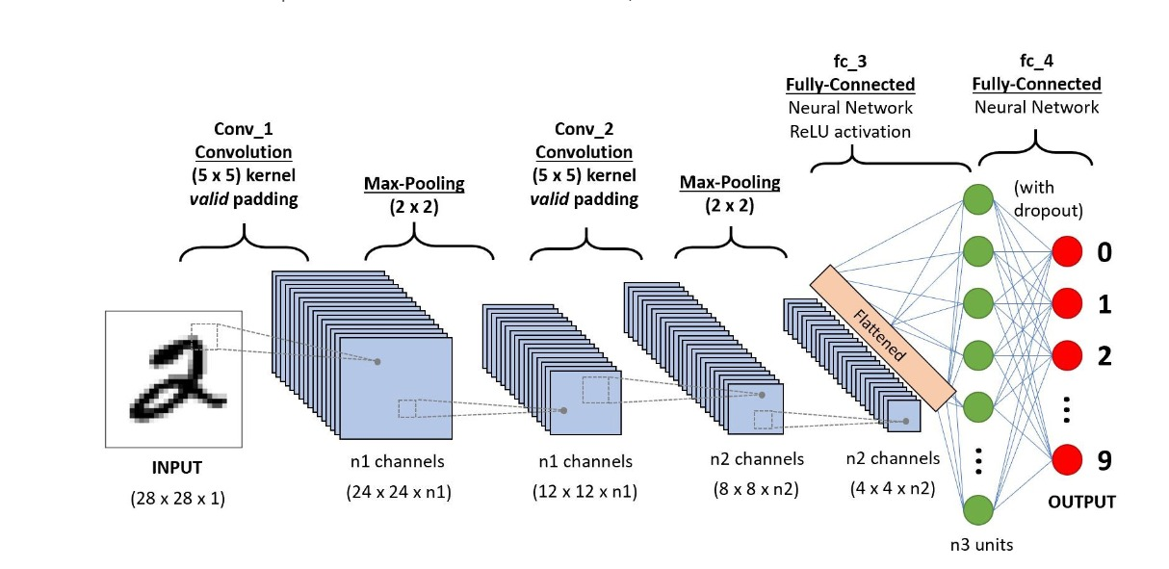
CNN Architecture
Initialize network parameters
Forward propagation
Loss function
Backpropagation
Training process
Evaluation process
Main execution
Fig 5: Working principle of CNN[deep learning tutorial]

Slide 11
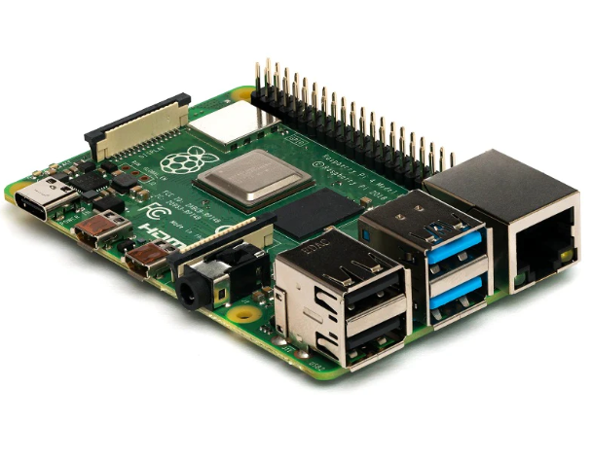
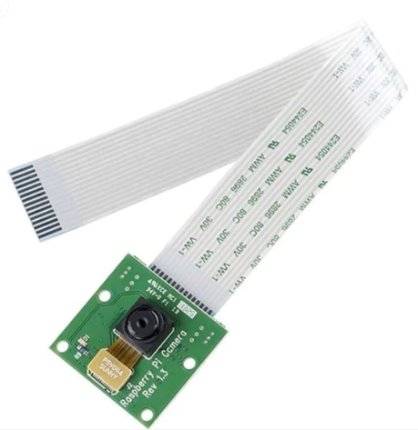
System Specifications
Raspberry Pi 4B:
Enhanced Performance
Versatile Connectivity
4K Video Capability
Diverse Applications
Camera Module:
An OmniVision OV5647 sensor with a fixed focus lens (aperture f/2.9).
A 54-degree field of view.
Designed for compatibility with Raspberry Pi boards equipped with a CSI connector.
Fig 6: Raspberry Pi 4B
Fig 7: Camera Module

Slide 12
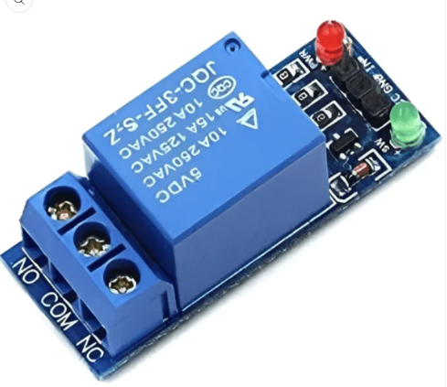
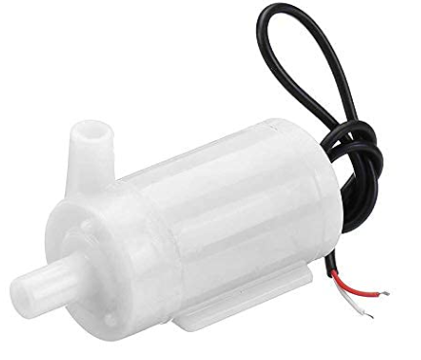
System Specifications Cont..
Relay:
An electromechanical switch that can be remotely controlled through network connectivity.
Mini water Project DC Pump:
It converts electrical energy into mechanical motion through electromagnetic principles.
It Comprises a stationary stator creating a magnetic field and a rotating rotor with an armature.
Fig 8: Relay
Fig 9: DC Pump

Slide 13
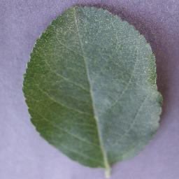
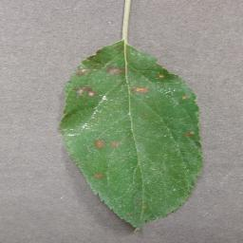
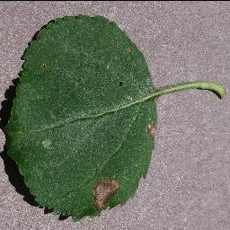
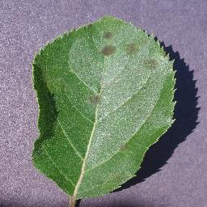
Datasets Description
The training dataset includes four distinct apple classes for plant disease detection:
Fig 10: Healthy Fig 11: Cedar Apple Rust Fig 12: Black Rot Fig 13: Apple Scab

Slide 14
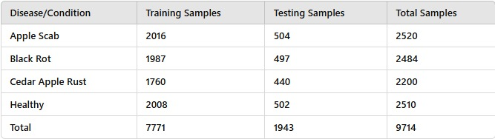
Datasets Description Cont..
The table summarizes the distribution of training and testing samples for different apple diseases and healthy conditions, with a total of 7,771 training samples and 1,943 testing samples across four categories.
Table 2: Data Description Table

Slide 15
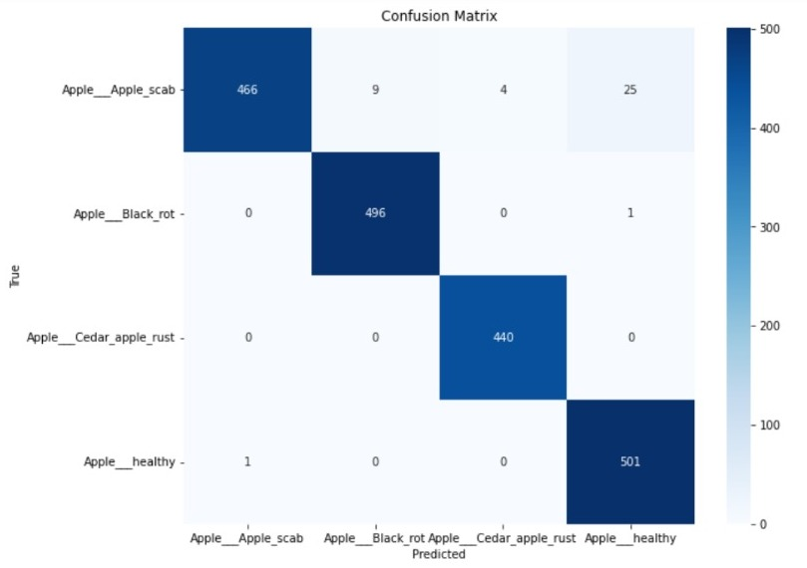
Datasets Description Cont..
Confusion Matrix Description:
Apple__Apple_scab:
True Positives: 466
False Positives: 38 (9 predicted as Black_rot, 4 as Cedar_apple_rust, 25 as healthy)
Apple__Black_rot:
True Positives: 496
False Positives: 1 (predicted as healthy)
Apple__Cedar_apple_rust:
True Positives: 440
False Positives: 0
Apple__healthy:
True Positives: 501
False Positives: 1 (predicted as Apple_scab)
Fig 14: Plant Disease Detection Confusion Matrix

Slide 16
Experimental Outcomes
Table 3: Smart IoT System Comparison: Metrics and Performance
Metric | Smart IoT System (CNN-based) | ANN-based Smart IoT System | Sensor-based System with Basic Temperature and Humidity Sensors | Sensor-based System with Advanced Soil and Air Quality Sensors
Accuracy of Disease Detection | 95% | 90% | 85% | 82%
Detection Time | 10 seconds | 12 seconds | 30 seconds | 25 seconds
Pesticide Usage Reduction | 45% reduction | 35% reduction | 20% reduction | 18% reduction
Coverage Area (per hour) | 2.5 acres | 2 acres | 1.5 acres | 1.2 acres
Model Complexity | High | Moderate | Low | Low
Data Requirement | High | Moderate | Low | Low
Hardware Requirements | High-end GPU | Moderate GPU | Low | Low
Ease of Integration | Moderate | Moderate | High | High
Training Time | Longer | Moderate | Short | Short
Real-time Processing | Excellent | Good | Fair | Fair

Slide 17
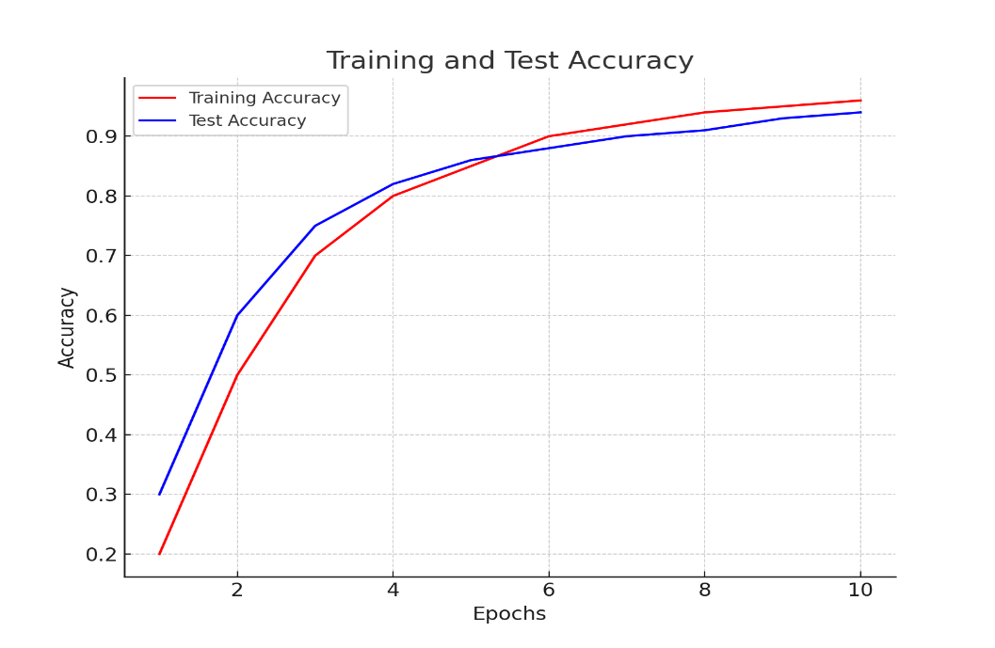
Experimental Outcomes
Fig 15: Training Accuracy v/s Validation Accuracy

Slide 18
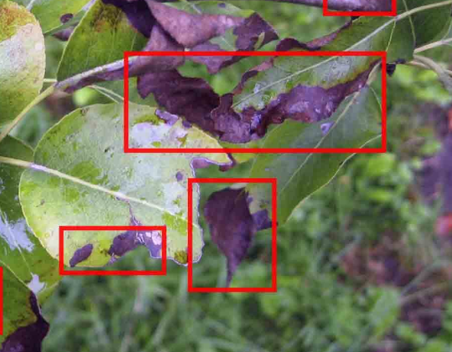
Summary
Ensures early disease detection.
Promotes resource efficiency.
Supports data-driven decision-making.
Scalable solution enhancing crop management and sustainability.
Ensures environmental protection.
It is cost efficient.
Fig 16: Leaf Disease detection

Slide 19
Future Scope
Several potential application areas:
Bio-diversity monitoring.
Forest fire detection and prevention
Agro monitoring system over large landscapes (like Millet mission, Tea garden)

Slide 20
Bibliography
[1]
[2]
[3]
[4]
Maes, W. H., & Steppe, K. (2019). Perspectives for remote sensing with unmanned aerial vehicles in precision agriculture. Trends in plant science, 24(2), 152-164.
Neupane, K., & Baysal-Gurel, F. (2021). Automatic identification and monitoring of plant diseases using unmanned aerial vehicles: A review. Remote Sensing, 13(19), 3841.
Morais, R., Silva, N., Mendes, J., Adão, T., Pádua, L., López-Riquelme, J. A., ... & Peres, E. (2019). mySense: A comprehensive data management environment to improve precision agriculture practices. Computers and Electronics in Agriculture, 162, 882-894.
Karunathilake, E. M. B. M., Le, A. T., Heo, S., Chung, Y. S., & Mansoor, S. (2023). The path to smart farming: Innovations and opportunities in precision agriculture. Agriculture, 13(8), 1593.

Slide 21
Bibliography Contd..
[5]
[6]
[7]
Kreuze, Jan, Julius Adewopo, Michael Selvaraj, Leroy Mwanzia, P. Lava Kumar, Wilmer J. Cuellar, James P. Legg, David P. Hughes, and Guy Blomme. "Innovative digital technologies to monitor and control pest and disease threats in root, tuber, and banana (RT&B) cropping systems: Progress and prospects." Root, Tuber and Banana Food System Innovations: Value Creation for Inclusive Outcomes (2022): 261-288.
Mendis, Omesha, Amanda Perera, Savindu Ranasinghe, and Sanjeevi Chandrasiri. "GreenEye: Smart Consulting System for Domestic Farmers." In 2022 4th International Conference on Advancements in Computing (ICAC), pp. 363-368. IEEE, 2022.
Dhaygude SB, Nitin PK (2013) Agricultural plant leaf disease detection using image processing. Int J Adv Res Electr Electron Instrum Eng 2(1)

Slide 22

22

